Slide 1
Example
Steps in the analysis
Plot the data
If the linear model is plausible, fit it.
Check the residual plots and fit a modified model, if necessary.
Evaluate the significance of the overall model via individual t terms, via t-tests.
Provide predictions and prediction intervals or confidence intervals on the mean
response, if required.

Slide 2
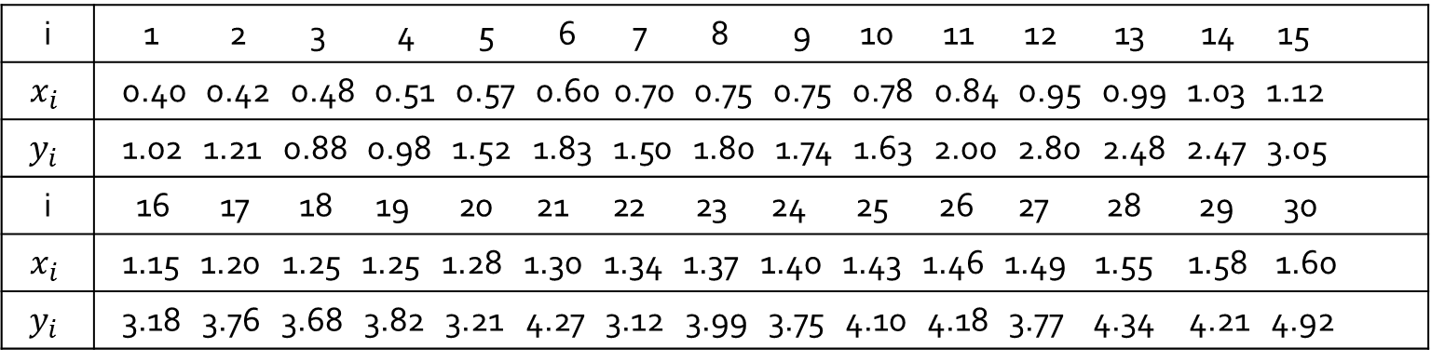
Palpebral fissure
Example 12.1 provides measurements of the ocular surface area (OCA) and the palpebral fissure width(the horizontal width of the eye opening) of 30 objects.
i | 1 2 3 4 5 6 7 8 9 10 11 12 13 14 15
$$x_{i}$$ | 0.40 0.42 0.48 0.51 0.57 0.60 0.70 0.75 0.75 0.78 0.84 0.95 0.99 1.03 1.12
$$y_{i}$$ | 1.02 1.21 0.88 0.98 1.52 1.83 1.50 1.80 1.74 1.63 2.00 2.80 2.48 2.47 3.05
i | 16 17 18 19 20 21 22 23 24 25 26 27 28 29 30
$$x_{i}$$ | 1.15 1.20 1.25 1.25 1.28 1.30 1.34 1.37 1.40 1.43 1.46 1.49 1.55 1.58 1.60
$$y_{i}$$ | 3.18 3.76 3.68 3.82 3.21 4.27 3.12 3.99 3.75 4.10 4.18 3.77 4.34 4.21 4.92

Slide 3
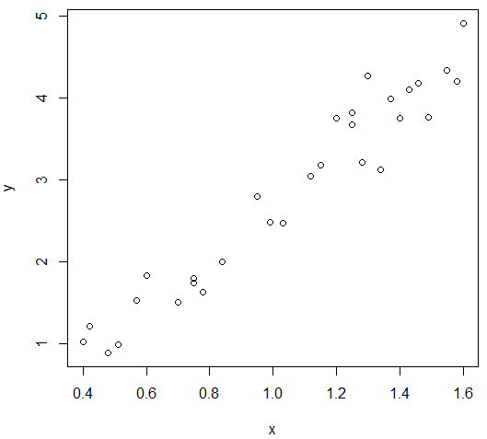
> with(xmp12.01, plot(y~x))

Slide 4
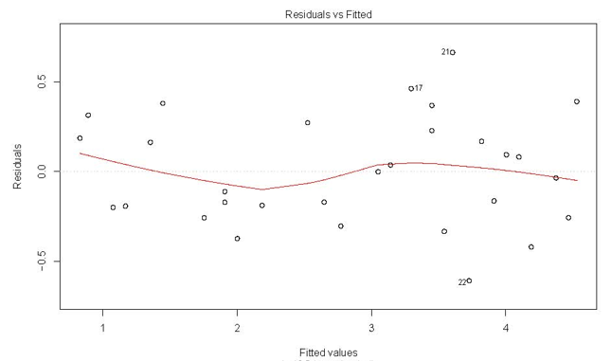
Residual Plot 1 for Palpebral
> plot(fm1$fitted.values, fm1$residuals)

Slide 5
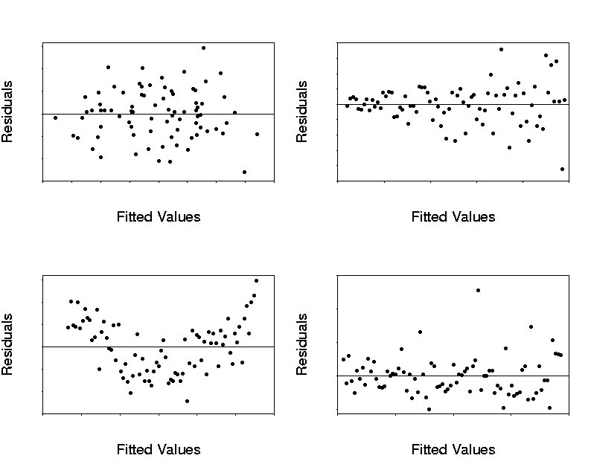
Residual Plots
Upper left: No noticeable pattern.
Upper right: Heteroscedastic.
Lower left: Trend.
Lower Right: Outlier.

Slide 6
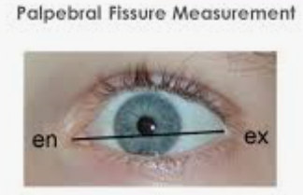
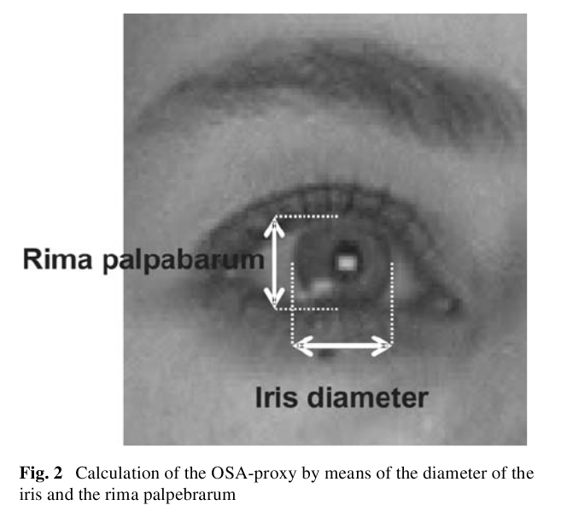

Slide 7
> summary(xmp12.01[, 2:3])
x y
Min. :0.400 Min. :0.880
1st Qu.:0.750 1st Qu.:1.755
Median :1.135 Median :3.085
Mean :1.051 Mean :2.840
3rd Qu.:1.363 3rd Qu.:3.808
Max. :1.600 Max. :4.920
> fm1 <- lm(y ~ x, data=xmp12.01)

Slide 8
> summary(fm1)
Call:
lm(formula = y ~ x, data = xmp12.01)
Residuals:
Min 1Q Median 3Q Max
-0.60942 -0.19875 -0.01902 0.21727 0.66378
Coefficients:
Estimate Std. Error t value Pr(>|t|)
(Intercept) -0.3977 0.1680 -2.367 0.0251 *
x 3.0800 0.1506 20.453 <2e-16 ***
---
Signif. codes: 0 ‘***’ 0.001 ‘**’ 0.01 ‘*’ 0.05 ‘.’ 0.1 ‘ ’ 1
Residual standard error: 0.308 on 28 degrees of freedom
Multiple R-squared: 0.9373, Adjusted R-squared: 0.935
F-statistic: 418.3 on 1 and 28 DF, p-value: < 2.2e-16

Slide 9
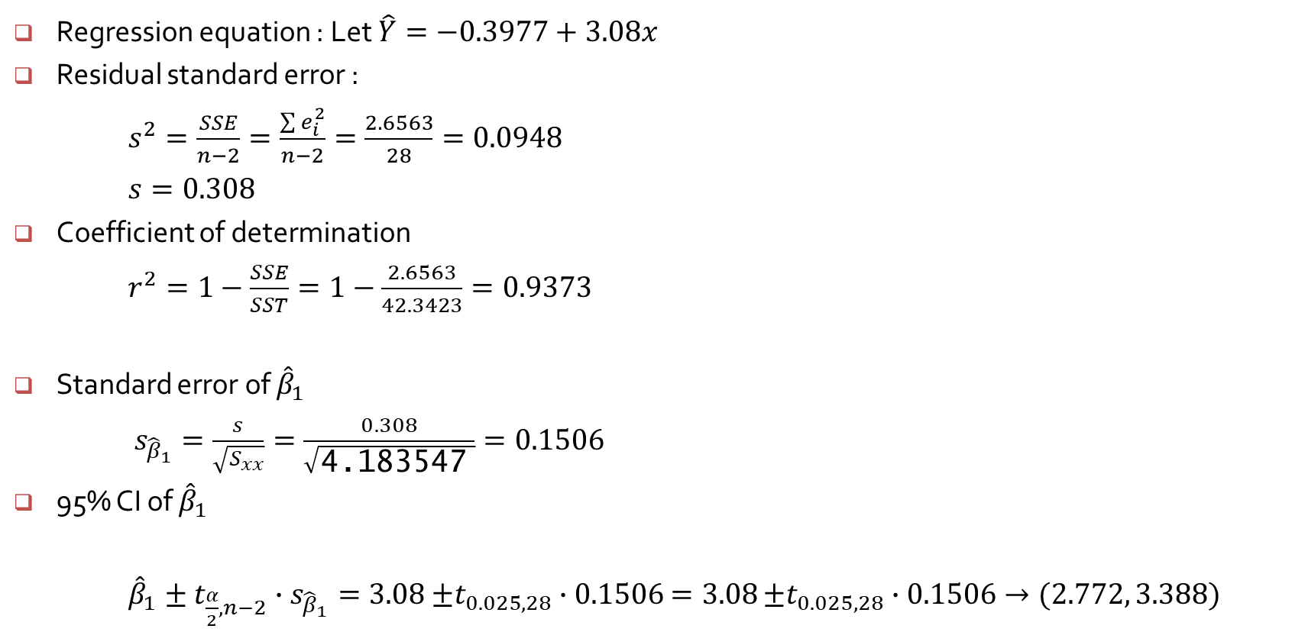
Regression equation : Let $\hat{Y}=−0.3977+3.08x$
Residual standard error :
$s^{2}=\frac{SSE}{n−2}=\frac{\sum{e_{i}^{2}}}{n−2}=\frac{2.6563}{28}=0.0948$
$s=0.308$
Coefficient of determination
$r^{2}=1−\frac{SSE}{SST}=1−\frac{2.6563}{42.3423}=0.9373$
Standard error of ${\hat{β}}_{1}$
$s_{{\hat{β}}_{1}}=\frac{s}{\sqrt{S_{xx}}}=\frac{0.308}{\sqrt{\text{4.183547} }}=0.1506$
95% CI of ${\hat{β}}_{1}$
${\hat{β}}_{1}±t_{\frac{α}{2},n−2}∙s_{{\hat{β}}_{1}}=3.08$ $±t_{0.025, 28}∙0.1506$ $=3.08$ $±t_{0.025, 28}∙0.1506→(2.772, 3.388)$

Slide 10
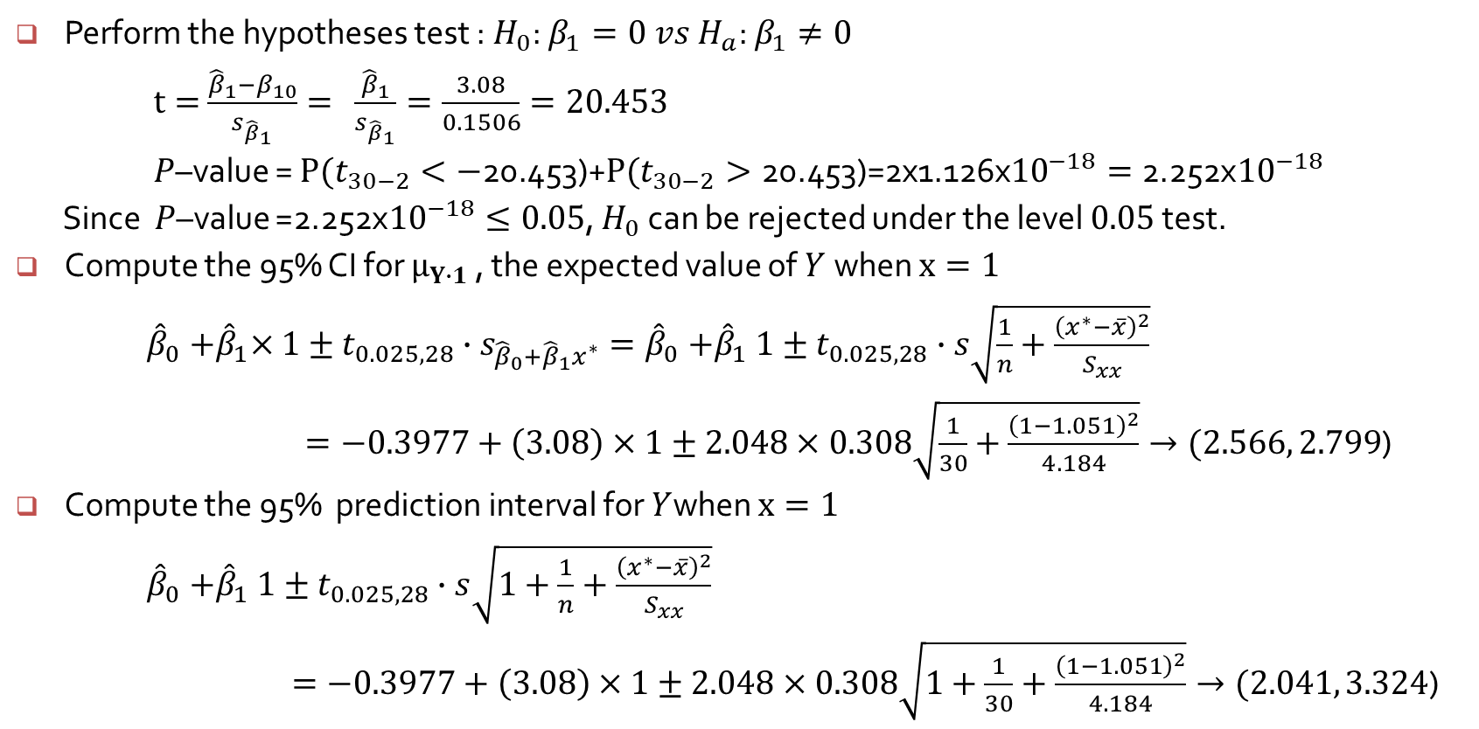
Perform the hypotheses test : $H_{0}$: $β_{1}=0 vs H_{a}\text{: }β_{1}≠0$
$t=$ $\frac{{\hat{β}}_{1}−β_{10}}{s_{{\hat{β}}_{1}}}= \frac{{\hat{β}}_{1}}{s_{{\hat{β}}_{1}}}=\frac{3.08}{0.1506}=20.453$
$P$–value = $P(t_{30−2}<−\text{20.453}\text{)}\text{+}P(t_{30−2}>\text{20.453)}\text{=2}\text{x}\text{1.126}\text{x}{10}^{−18}=\text{2.252}\text{x}{10}^{−18}$
Since $P$–value =$\text{2.252}\text{x}{10}^{−18}≤0.05$, $H_{0}$ can be rejected under the level $0.05$test.
Compute the 95% CI for $μ_{Y∙1}$ , the expected value of $Y$when $x=1$
${\hat{β}}_{0}{+\hat{β}}_{1}×1±t_{0.025, 28}∙s_{{\hat{β}}_{0}+{\hat{β}}_{1}x^{∗}}={\hat{β}}_{0}{+\hat{β}}_{1}1±t_{0.025, 28}∙s\sqrt{\frac{1}{n}+\frac{{\left(x^{∗}−\overline{x}\right)}^{2}}{S_{xx}}}$
$=−0.3977+\left(3.08\right)×1±2.048×0.308\sqrt{\frac{1}{30}+\frac{{\left(1−1.051\right)}^{2}}{4.184}}→(2.566, 2.799$)
Compute the 95% prediction interval for $Y$when $x=1$
${\hat{β}}_{0}{+\hat{β}}_{1}1±t_{0.025, 28}∙s\sqrt{1+\frac{1}{n}+\frac{{\left(x^{∗}−\overline{x}\right)}^{2}}{S_{xx}}}$
$=−0.3977+\left(3.08\right)×1±2.048×0.308\sqrt{1+\frac{1}{30}+\frac{{\left(1−1.051\right)}^{2}}{4.184}}→(2.041, 3.324$)

Slide 11
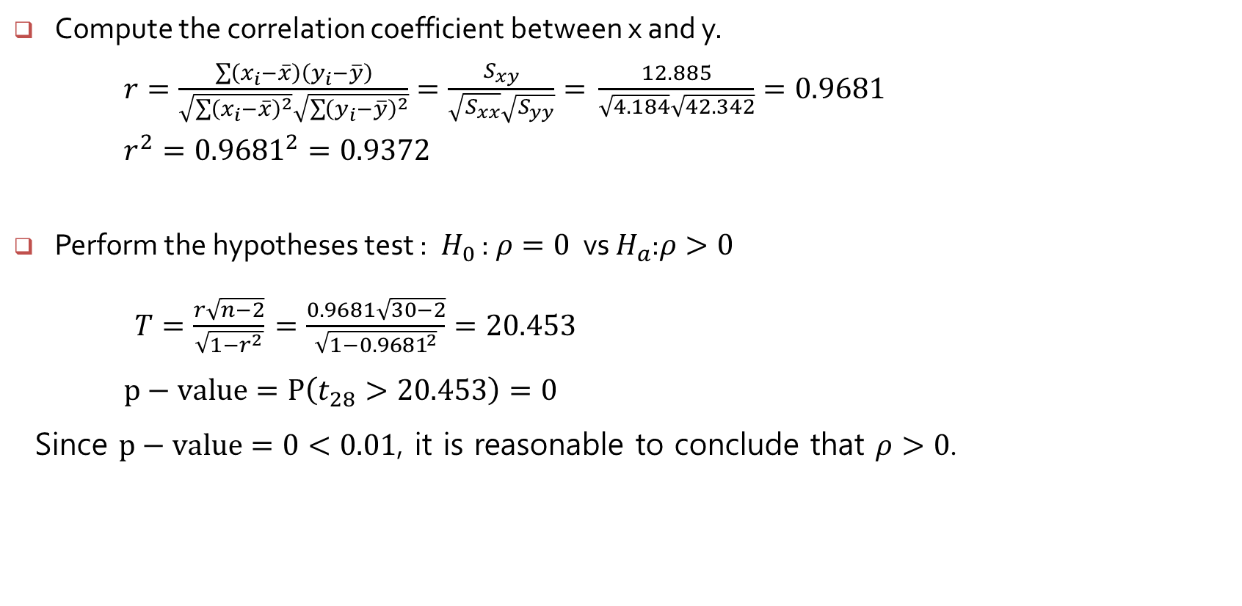
Compute the correlation coefficient between x and y.
$r=\frac{\sum{\left(x_{i}−\overline{x}\right)}\left(y_{i}−\overline{y}\right)}{\sqrt{\sum{{\left(x_{i}−\overline{x}\right)}^{2}}}\sqrt{\sum{{\left(y_{i}−\overline{y}\right)}^{2}}}}=\frac{S_{xy}}{\sqrt{S_{xx}}\sqrt{S_{yy}}}=$ $\frac{12.885}{\sqrt{4.184}\sqrt{42.342}}=0.9681$
$r^{2}={0.9681}^{2}=0.9372$
Perform the hypotheses test : $H_{0}$ :$ρ=0$ vs $H_{a}$:$ρ>0$
$T=\frac{r\sqrt{n−2}}{\sqrt{1−r^{2}}}$ $=\frac{0.9681\sqrt{30−2}}{\sqrt{1−{0.9681}^{2}}}=20.453$
$p−value=P\left(t_{28}>20.453\right)=0$
Since $p−value=0<0.01$, it is reasonable to conclude that $ρ>0$.

Slide 12
Residual Plot 1 for Palprebal
> plot(fm1$fitted.values, fm1$residuals)

Slide 13
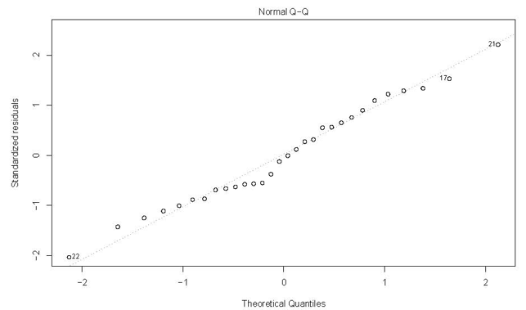
> fm1.stdres = rstandard(fm1)
> qqnorm(fm1.stdres)

Slide 14
Fitted values
> head(fm1$fitted.values, n=10)
1 2 3 4 5 6 7
0.8342480 0.8958474 1.0806454 1.1730444 1.3578424 1.4502415 1.7582382
8 9 10
1.9122365 1.9122365 2.0046356
Residuals
> head(fm1$residuals, n=10)
1 2 3 4 5 6 7
0.1857520 0.3141526 -0.2006454 -0.1930444 0.1621576 0.3797585 -0.2582382
8 9 10
-0.1122365 -0.1722365 -0.3746356

Slide 15
Evaluation of predictions
Suppose we wish to evaluate the predictions in the OSA data at 0.6, 1.0, and 1.4.
> predict(fm1, list(x=c(0.6, 1, 1.4)))
1 2 3
1.450241 2.682228 3.914215
We can evaluate the fitted values and their standard errors as
> predict(fm1, list(x=c(0.6, 1, 1.4)), se=TRUE)
$fit
1 2 3
1.450241 2.682228 3.914215
$se.fit
1 2 3
0.08821348 0.05676328 0.07693567
$df
[1] 28
$residual.scale
[1] 0.3080088

Slide 16
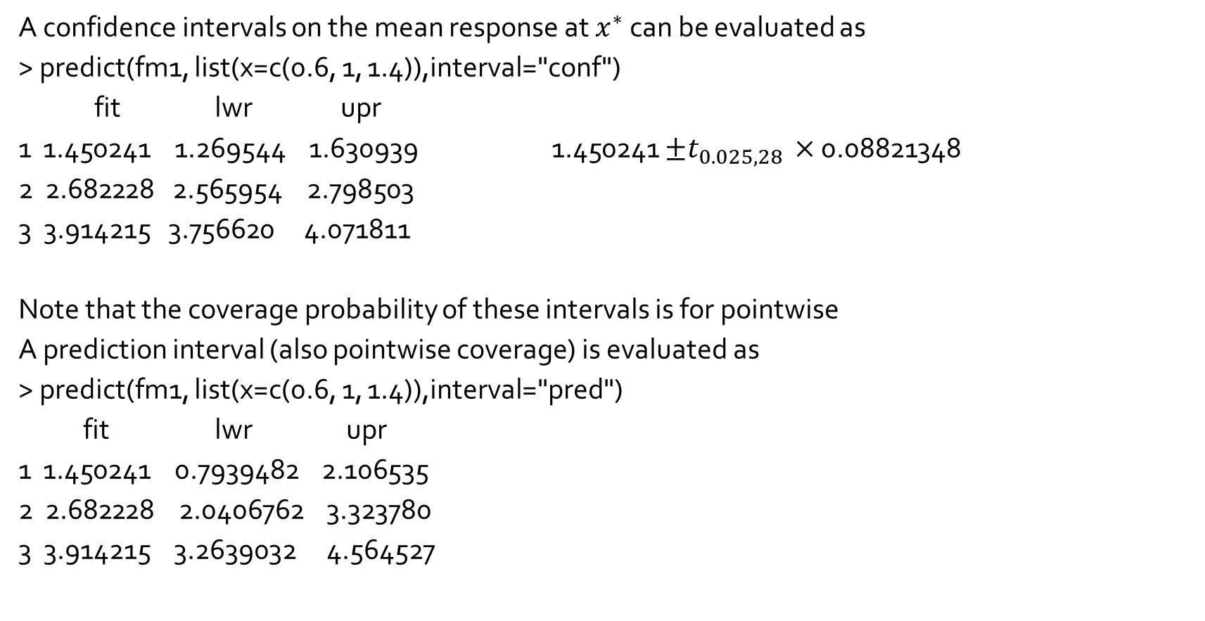
Confidence intervals on the mean response
A confidence intervals on the mean response at $x^{∗}$ can be evaluated as
> predict(fm1, list(x=c(0.6, 1, 1.4)),interval="conf")
fit lwr upr
1 1.450241 1.269544 1.630939 1.450241 $±t_{0.025,28 }×$ 0.08821348
2 2.682228 2.565954 2.798503
3 3.914215 3.756620 4.071811
Note that the coverage probability of these intervals is for pointwise
A prediction interval (also pointwise coverage) is evaluated as
> predict(fm1, list(x=c(0.6, 1, 1.4)),interval="pred")
fit lwr upr
1 1.450241 0.7939482 2.106535
2 2.682228 2.0406762 3.323780
3 3.914215 3.2639032 4.564527

